Slide 1
Dissertation Proposal

Slide 2
Principais referências
☆ Ribeiro, Marco Tulio, Singh, Sameer, and Guestrin, Carlos. “why should I trust you?”: Explaining the predictions of any classifier. In Knowledge Discovery and Data Mining (KDD), 2016. (833 citações)
☆ Ribeiro, Marco Tulio, Sameer Singh, and Carlos Guestrin. "Model-agnostic interpretability of machine learning." arXiv preprint arXiv:1606.05386(2016). (52 citações)
Di Nucci, Dario, et al. "Detecting code smells using machine learning techniques: are we there yet?." 2018 IEEE 25th International Conference on Software Analysis, Evolution and Reengineering (SANER). IEEE, 2018. (7 citações)
☆ Maneerat, Nakarin, and Pomsiri Muenchaisri. "Bad-smell prediction from software design model using machine learning techniques." Computer Science and Software Engineering (JCSSE), 2011 Eighth International Joint Conference on. IEEE, 2011. (24 citações)

Slide 3
Principais referências
☆ Fontana, Francesca Arcelli, et al. "Comparing and experimenting machine learning techniques for code smell detection." Empirical Software Engineering 21.3 (2016): 1143-1191. (66 citações)
☆ Fontana, Francesca Arcelli, Pietro Braione, and Marco Zanoni. "Automatic detection of bad smells in code: An experimental assessment." Journal of Object Technology 11.2 (2012): 5-1. (114 citações)
Fontana, Francesca Arcelli, et al. "Code smell detection: Towards a machine learning-based approach." Software Maintenance (ICSM), 2013 29th IEEE International Conference on. IEEE, 2013. (48 citações)

Slide 4
Contexto de pesquisa
☆ Ribeiro, Marco Tulio, Sameer Singh, and Carlos Guestrin. "Model-agnostic interpretability of machine learning."
Importance of IML:
Trust: how much can understand e predct the model behavior
System designer is better equiped to improve model
Feature engineering
Parameter tuning
Replacing the model with a diferente one.
Solutions
Use "interpretable models"
Treating original model as a black box.
Extract post-hoc explanations: model agnostic
Extracting post-hoc explanations:
learning an interpretable model on the predictions of the black box model (Craven & Shavlik, 1996; Baehrens et al., 2010),
perturbing inputs and seeing how the black box model reacts (Strumbelj & Kononenko, 2010; Krause et al., 2016),
or both (Ribeiro et al., 2016).

Slide 5
Contexto de pesquisa
Model flexibility
Model is treated as a black box
Frees up the model to bel as flexibel as necessery for the task
Explanation flexibility
the same model can be explained with different types of explanations, and different degrees of interpretability for each type of explanation.
Representation Flexibility
Lower Cost to Switch
Comparing two models
models being compared can be explained using the same techniques and representations

Slide 6
Contexto de pesquisa
Ribeiro, Marco Tulio, Singh, Sameer, and Guestrin, Carlos. “why should I trust you?”: Explaining the predictions of any classifier

Slide 7
Objetivos gerais e específicos
Objetivos gerais
Evaluate and understand code smell predictions through the most recent research in in-terpretability of machine learning techniques.
Objetivos específicos
Summarise the effectivity of each algorithm for each code smell type;
Evaluate how interpretable are machine learning models for code smell prediction,providing qualitative understanding of the relationship between the instance’s features and the model’s predictions. [18];
Check developer’s confidence regarding to generated models that predicts code smells;
Check the relationship between effectivity of code smell predictions and interpretabil-ity

Slide 8
Proposal relevance
Our study intend to provide a valuable contribution to code smell detection using machine learning techniques. While previous studies focus on performance, i. e. effectivity andefficciency of predictions, we focus on interpretability. A interpretable aproacch of machinelearning might lead to a better understanding of the reasons behind each predicion, whethermodel is black box or not.

Slide 9
Study design
This study aims to investigate how interpretable are the code smells predictions throughdeveloper’s eyes . In this way, three main research questions will guide this study:

Slide 10
Study design
RQ1: How interpretable are the chosen machine learning techniques over code smelldetection?
Interpretability is the way to provide a guided user decision. It‘s note the end itself
RQ2: How applicable are the predictions under developer’s perspective?
How confident is end user to apply shown predictions
RQ3: What’s the relationship between effectivity of each tested algorithm and interpretability?

Slide 11
Study design
Gathering training and test data
Collect some heterogeneous software systems: we will use some software systems tobe analyzed - extract metrics and look for code smells. A list of these software isshown on Table 2. They are Java-based and they are relevant on software communitydue to its high number of commits, active community and its heterogenity

Slide 12
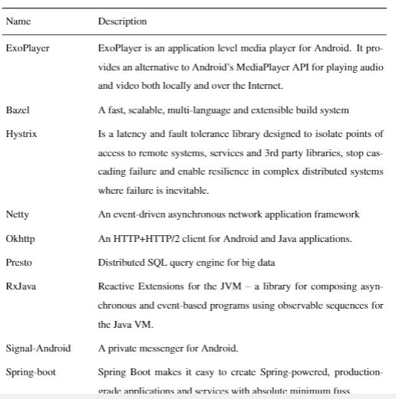
Study design
Gathering training and test data

Slide 13
Study design
Gathering training and test data
Metrics Extraction: extract a large set of object-oriented metrics from systems at class,method, package and project levels. The metrics are considered as independent vari-ables in the machine learning approach.
Tool to parse the source code of Java projects through the Eclipse JDT library: “Design Features and Metrics for Java” (DFMC4J). ** understand – faz a coleta de métricas no software**

Slide 14
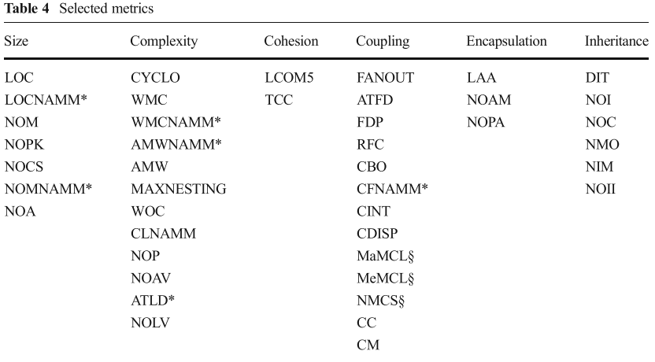
Study design

Slide 15
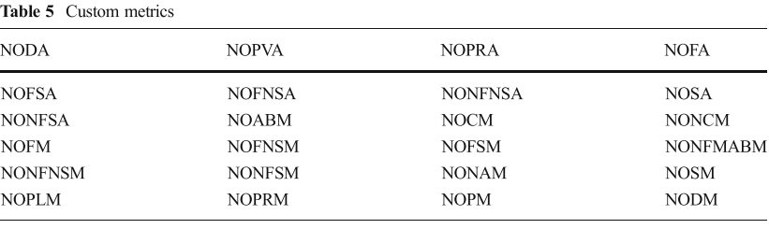
Study design

Slide 16
Study design
Gathering training and test data
Choice of tools, or rules, to detect code smells: to establish the dependent variablefor code smell prediction models, we applied for each code smell the set of automaticdetectors shown in Table 4

Slide 17
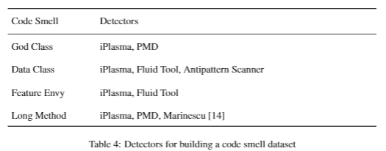
Study design

Slide 18
Study design
Gathering training and test data
Application of the chosen detectors on the systems, recording the results for each classand method.
Labeling: following the output of the code smell detectors, the reported code smellcandidates are manually evaluated, and they are assigned as YES, if he agrees that thecode snippet contained the specified smell type, and NO, otherwise. Regard manualevaluation, we intend to recruit about 10 developers with at least 3 years experience insoftware development and code smell detection, from industry and academy.

Slide 19
Study design
Gathering training and test data
Training phase: The manual labeling along with object-oriented metrics are used totrain supervised classifiers. These classifiers were chosen due to its adoption in previ-ous experiments [4][2][8], assessing high accuracy . The scope of algorithms analyzedin our study is:
(a) J48
b) JRIP
(c) Random Forest
(d) Naive Bayes(e)
SMO
(f) SVM

Slide 20
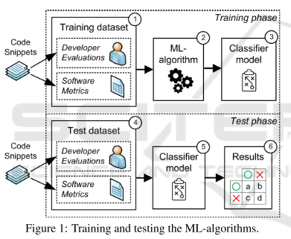
Study design
Gathering training and test data

Slide 21
Study design
Furthermore, to test the performance of the different code smell prediction modelsbuilt, we will apply 10-fold cross validation [2]

Slide 22
Study design
Operation
Operation and Data Analysis
The same participants of labeling phase above will be invited to participate of next procedures. The datasets above will be splitted in groups, each one for the respective algorithmand code smell type
The testing sets will be grouped by code smell and algorithm (see following effectivity summary)

Slide 23
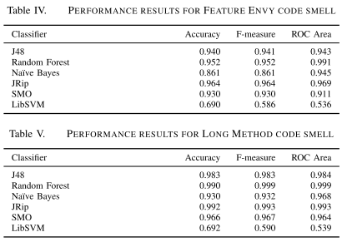
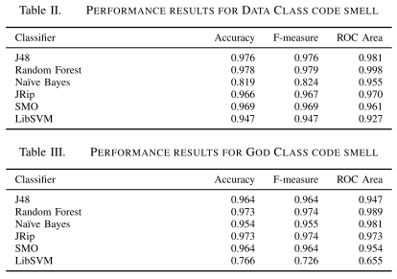
Study design

Slide 24
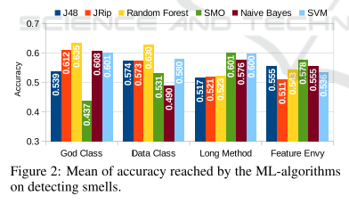
Study design

Slide 25
Study design
RQ1
RQ2:
sample radomly 20 (more or less?) instances from each trained dataset (specific algorithm and code smell) to be analyzed by each subject.
Apply some interpretability technique for each instance (user-friendly)
***LIME (Local Interpretable Model-agnostic explanations)
Partial dependence
Feature importance
The accpected answer isYES, if he is able to interpret it and if the prediciton is feasible , and NO otherwise

Slide 26
Study design
RQ2: EXPECTED RESULT

